Slide 1
“Expenditure distributor Management”
Author: Aakash Bisen

Slide 2
Objective:
this project requires you to build an application that allows users to create a group, track their expenses, get them approved by other group members, distribute expenses fairly, make payments to each other, and view past expenses statistics.
Benefits:
The application has enriched with online dedicated payment gateway feature, which allow members to pay each other at the same portal. This feature makes it easy for group members to repay each other for expenses without having to use a separate payment platform.
this application can be used to allow users to see the statistics for their past expenses to manage & their financial plan or budget accordingly.

Slide 3
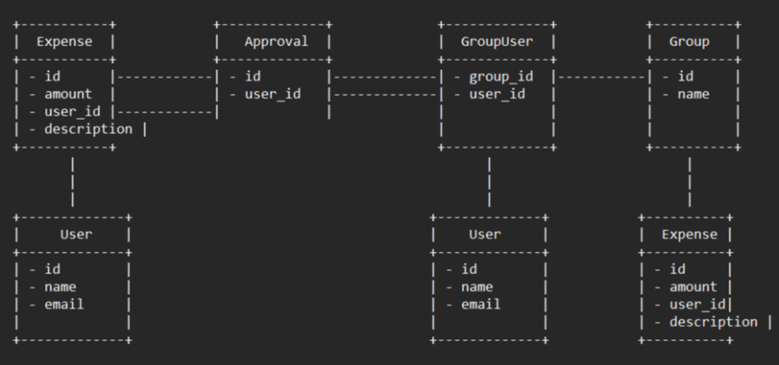
Architecture design

Slide 4
In this diagram, the boxes represent the classes/entities, and the arrows represent the relationships between them. Here's a brief description of each entity:
USER: represents a user of the expense service. Each user has a unique id, a name, and an email.
EXPENSE: represents an expense that a user has incurred. Each expense has a unique id, an amount, a description, and a user_id field that references the User that incurred the expense.
APPROVAL: represents an approval for an expense by a user. Each approval has a unique id, an expense_id field that references the Expense being approved, and a user_id field that references the User giving the approval.
GROUPUSER: represents the membership of a user in a group. Each GroupUser has a group_id field that references the Group that the user is a member of, and a user_id field that references the User that is a member of the group.
GROUP: represents a group of users who share expenses. Each group has a unique id, and a name. The relationships between the entities are represented by the arrows in the diagram. For example, each Expense is associated with a User, and this is represented by the arrow pointing from Expense to User. Similarly, each Approval is associated with an Expense and a User, and this is represented by the arrows pointing from Approval to Expense and User, respectively.

Slide 5
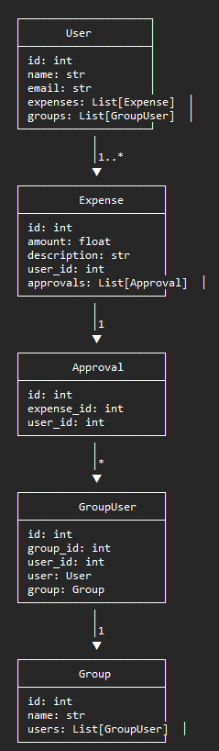
In this low level design, these arrows represent the relationships between entities. For example, a User object has a one-to-many relationship with Expense objects, as represented by the arrow pointing from User to Expense with a "1..*" label. Each Expense object has exactly one User object associated with it, as represented by the arrow pointing from Expense to User with a "1" label. Similarly, a Group object has a one-to-many relationship with GroupUser objects, and each GroupUser object has exactly one User and one Group associated with it.

Slide 6
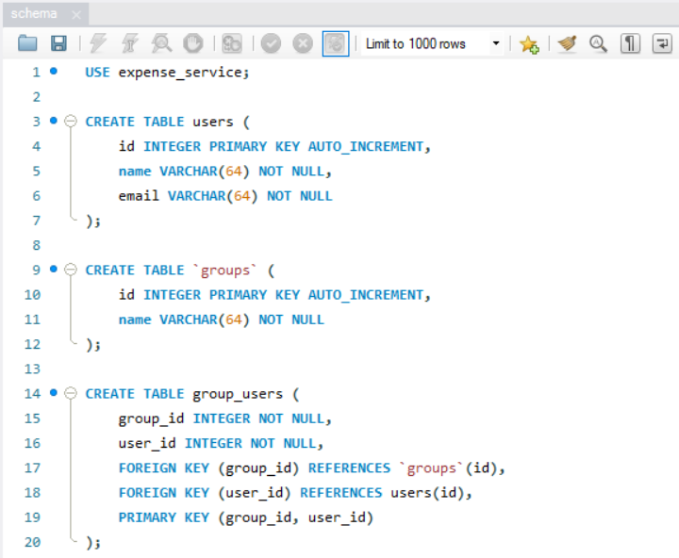
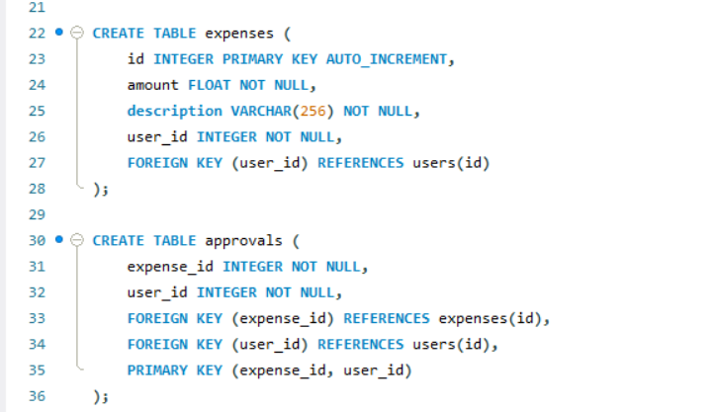
DATABASE:
System stores every request into the database(mentioned in 2.1 above) in such a way that it is easy to retrain the model.
The system stores every expense/transaction spent by user in schema.
The User gives required information(if needed).
The system stores each and every data given by the user or received on request to the database.

Slide 7
conclusion:
The application of distribution management has been successfully created. It’ll distribute expenditure among participants and also allows users to create a group, track their expenses, get them approved by other group members, distribute expenses fairly, make payments to each other, and view past expenses statistics

Slide 8
Q & A:
q1) what kind of relationship does user object has with expense object?
a user object has a one-to-many relationship with expense objects.
q 2) how approval system works in the application?
represents an approval for an expense by a user. each approval has a unique id, an expense_id field that references the expense being approved, and a user_id field that references the user giving the approval.
q 3) what’s the complete flow you followed in this project?
refer slide 3rd for better understanding.

Slide 9
q 5) how logs are managed?
the application code has implemented log of every event so that the user will know what process is running internally.
q 6)how one can create a group in this application?
each groupuser has a group_id field that references the group that the user is a member of, and a user_id field that references the user that is a member of the group and each group has a unique id, and a name. the relationships between the entities are represented by the arrows in the diagram(refer slide 3^{rd)}

